Slide 1

SatFireWatch
Fire Prediction Software and Services
Universeh - Satellite Communications, Regulation and Business
21.12.2023.
University of Luxembourg: Maria Barral, Hind Djafaar, Zagorka Ristic.
University of Touluse: Youssef El Mendili, Ryad Madi, Leonard Painteaux, Yahya Younes.

Slide 2




ABOUT US
Our Team
We offer a cutting-edge technology to safeguard our communities and ecosystems from the devastating impact of wildfires by leveraging our LEO satellite constellation for unparalleled accuracy.
Engineers
IT
Marketing
Commercial
Our mission is to provide advanced fire prediction software that will empower governments, emergency services, and communities to take swift and effective measures to mitigate the risks of wildfire.

Slide 3
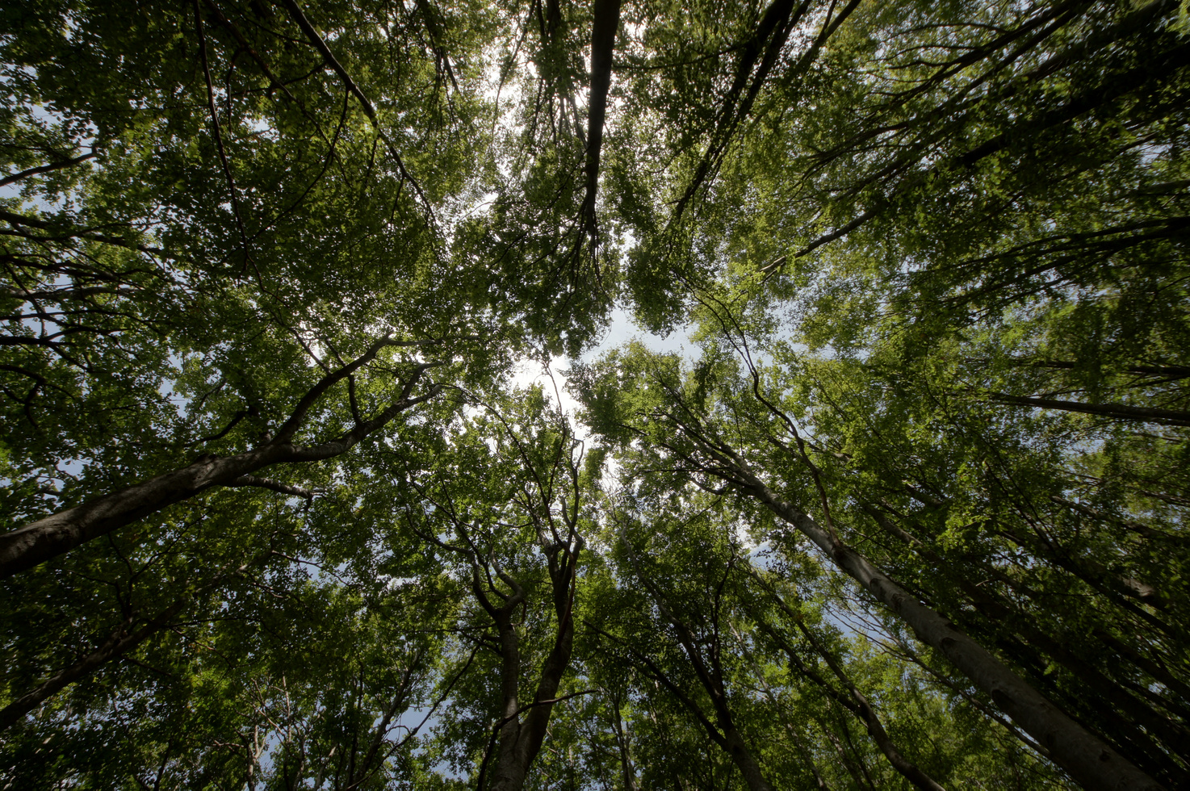




Our Vision
Our vision is to harness cutting-edge satellite technology to safeguard the delicate balance of nature, protecting forests, wildlife, and human lives.
By utilizing predictive analytics, we strive to detect potential wildfires before they escalate, enabling timely intervention and prevention measures.
Through our innovative approach, we aspire to be the forefront guardians of the environment, fostering a sustainable coexistence between humanity and the natural world.

Slide 4
Join us in revolutionising access to ideas and emerging technologies.

Slide 5

Our Product and Services
Wildfire Detection App
Real-time alerts and proactive solutions for a safer, more resilient world
Our app, powered by innovative wildfire prediction software and data from our LEO satellite constellation, provides real-time detection, while our comprehensive services offer valuable insights, data sales, and expert consulting for seamless integration into environmental management strategies.
Wildfire Prediction Software and Data
Advanced prediction software, coupled with the option to access and utilize our comprehensive wildfire data for informed decision-making
Consulting and Integration Services
Our expert consulting and seamless integration services are tailored to enhance your environmental risk management capabilities

Slide 6
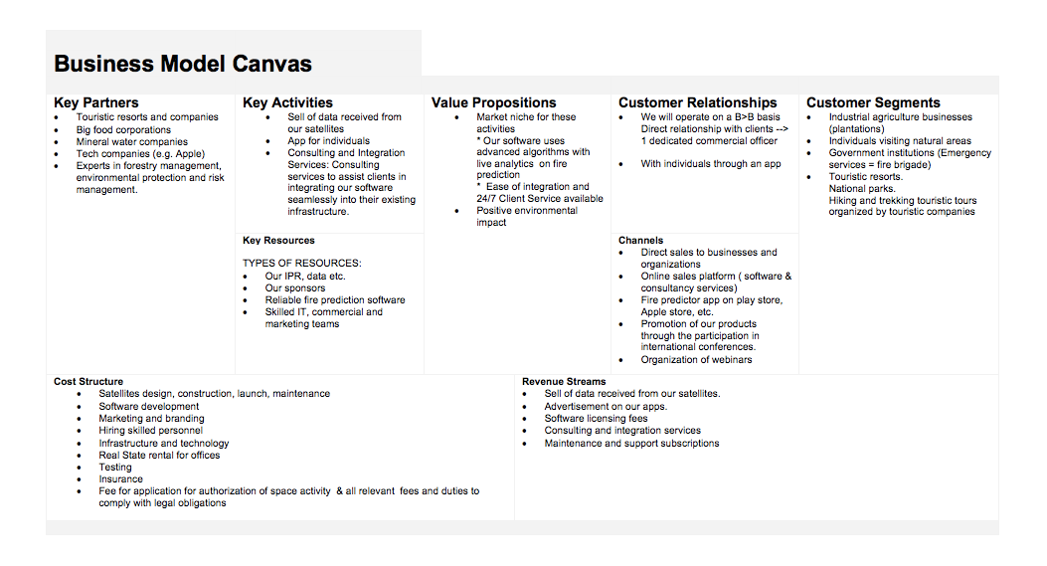

Slide 7
Strengths
Weaknesses
Innovative Technology
Fast Transmission of Data
High Resolution Satellite Imagery
Early Warning System
Scalability
Customization
Data Integration
Wildlife Conservation
Dependance on Data Accuracy
Initial Investment
Market Education
Regulatory Challenges
Infrastructure Requirements
Complexity of Maintaining the Proper Functioning of the Constellation
SWOT
Opportunities
Threats
Growing Awareness of Wildfire Risks
Developing Technology for Rapid Fire Detection
Collaboration with Authorities
Continuous Improvement
Positive Environmental Impact
Competition
Data Security Concerns
Climate Change Uncertainties
Budget Constraints
Regulatory Changes
Risk of Satellite Damage from Space Debris

Slide 8
Tows
STRENGTHS
WEAKNESSES
S&O
O&W
Leverage innovative technology to capitalize on the growing wildfire concern.
Our software is based on cutting-edge technology that provides real time data and insights to help landowners prevent and manage wildfires.
Seek funding and strategic partnerships to overcome financial constraints and increase market awareness.
Collaborate with insurance companies to offer financial incentives for users.
OPPORTUNITIES
S&T
T&W
Enhance marketing efforts to establish the start-up as a leader in the wildfire prevention market.
Continuously innovate to stay ahead of potential competition .
Focus on building a strong user community to counter public resistance through transparency and user education.
Changes in weather patterns could increase the risk of wildfires, which could put pressure on the company to develop new and innovative solutions.
Explore cost-effective ways to improve data accuracy and reduce dependence on external sources.
THREATS

Slide 9
V
R
Valuable
Rare
The software can collect and analyze data from a variety of sources, including sensors, weather data and satellite imagery to identify potential fire hazards and predict fire risk.
Forest fires are a major threat to ecosystems and human safety, and our software can help to reduce the risk of fires by providing early warning and prevention measures.
The software is based on proprietary algorithms and data analysis techniques that are not available to competitors.
The proactive approach of not only providing data but also offering consulting and integration services sets our company apart.
I
O
Inimitable
Organization
The specific capabilities and coverage offered by our satellite network contribute to the inimitability of our data sources for wildfire prediction.
We have developed proprietary algorithms and software for wildfire prediction, making it challenging for competitors to replicate the accuracy and efficiency achieved by our predictive analytics.
The depth of expertise within our organizational team, encompassing satellite technology, data analytics, and environmental science, forms a unique competency that is not easily duplicated.
Our diverse and skilled team members bring their expertise in satellite technology, data analytics, and environmental sciences as well as for the development and maintenance of our App.
We are developing partnerships and collaborations with research institutions, governmental bodies, and technology partners.
We are committed to continuous improvement through technology upgrades, and a proactive approach by incorporating feedback and staying at the forefront of advancements in wildfire prediction and environmental monitoring.

Slide 10
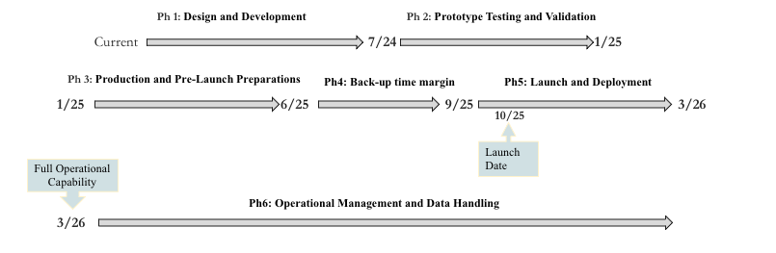
PRODUCTION ROADMAP

Slide 11
MARKET
Market Opportunity
Call to Action
Key Customer Segments
Growing Demand: rapidly expanding market for Earth observation & environmental data
Unique Value: high-frequency and high-resolution imagery for effective wildfire prediction
Urgent Need: escalating impact of wildfires due to climate change
Market Gap: lack of tailored, affordable observation services for wildfire detection
Technological Advancement: optimal time for CubeSat deployment due to technological advancements
Impact: significant economic and social benefits such as public safety and environmental conservation
Government Agencies including Fire Departments and Agencies Responsible for Forest Protection
Agricultural Stakeholders
Research Institutions
Environmental Organizations
Oil and Gas Companies and Timber Companies in wildfire-prone regions
Insurance Companies
Private Landowners
Private Individuals using our App

Slide 12



COMPETITION
Space Agencies: NASA, ESA, operate satellites equipped with sensors capable of monitoring Earth's surface for signs of wildfires.
Private Satellite Companies: Planet, Maxar Technologies, and Airbus Defence and Space operate constellations of Earth observation.
Research Institutions and Universities: conduct research on wildfire detection methods using satellite data & development of algorithms for more accurate and timely wildfire detection.
Data Analytics and AI Companies: exploring ways to enhance wildfire detection using satellite imagery.

Slide 13
GO TO MARKET PHASE
Target Market Identification
Marketing and Distribution Strategies
Pricing Model
Key Partnerships
Launch Timeline and Milestones
Sales and Support Plan
Primary Market Segments: Forestry departments in wildfire-prone regions
Secondary Market Segments: Private forestry companies and envirnmental NGOs
Digital Marketing: SEO-focused content on wildfire prevention, LinkedIn campaigns targeting forestry professionals
Distribution: Direct sales and partnerships with environmental agencies for broader outreach
For Individuals - our App:
30 logins for free + advertisement, then a one-time paiement of 9.99 €
For companies:
wildfire prediction software license plan, app included
raw satellite data purchase
consulting and integration services
Premium package
Strategic Partners: Collaboration with the National Fire Protection Association for knowledge sharing
Tech Partnerships: Integration with existing envirnmental monitoring platforms
Launch Date: Q3 2025
Milestones: 500 subscriptions by Q4 2025; Partnerships with two major forestry departments by Q2 2026
Dedicated sales team focusing on B2B clients
24/7 customer support with a specialized focus on emergency response.

Slide 14
RISK OPPORTUNITY MATRICES
 | Insignificant | Minor | Moderate | Major | Catastrophic
Very Likely | Technology Advancements | Technical Glitches | Cost Overruns | Changes in Zoning Laws | Data Leak or Breach
Likely | Geopolitical Risks | Regulatory Changes | Geomagnetic Storms | Cybersecurity Threats | Supplier/ Manufacturer Issues
Possible | Public Trust | Interference from Other Satellites | Equipement Breakdowns | Orbital Congestion | Launch Failure
Unlikely | Team Collaboration Issues | Communication Failure | Satellite Malfunction | Solar Activity Impact | Human Error
Very Unlikely | Unexpected Site Conditions | Natural Disasters | Component Degradation | Space Debris Collision | Satellite Aging

Slide 15


Hypotheses
LEO satellites enable timely prediction of wildfire.
High resolution imaging contributes to accurate identification and monitoring of wildfire-prone locations.
Constant monitoring increases effectiveness.
Global coverage increases service reach.
Rapid data transmission facilitates quick response.
Wildfire prediction contributes to environmental protection.
There is a viable market for our business model.

Slide 16

Questions

Slide 17

THANK YOU

